Slide 1
Week 5th
Prepared by Dr Syed Khaldoon Khurshid
Powered by Brilliant Application

Slide 2
Searching for solutions

Slide 3
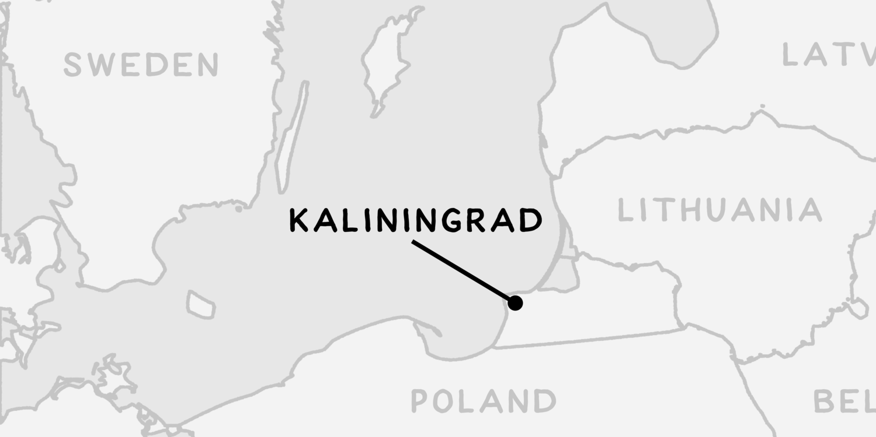
The Russian city of Kaliningrad lies about 30 kilometers north of Poland, where the Pregolya river meets the Baltic Sea.

Slide 4
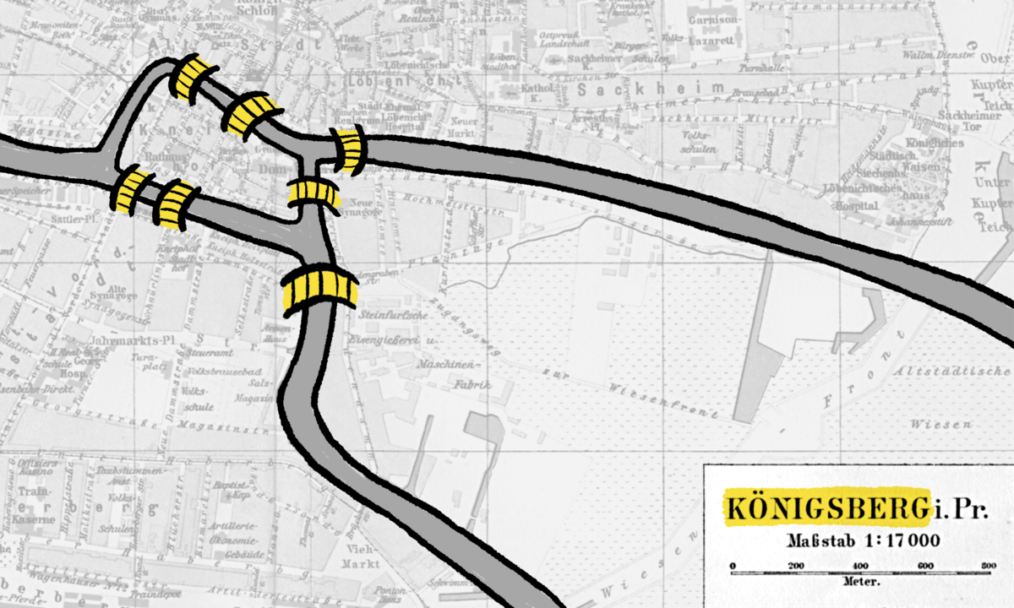
The city has a famous place in mathematical history dating back to the eighteenth century, when the city was named Königsberg and had seven bridges connecting two river islands in the heart of the city.

Slide 5
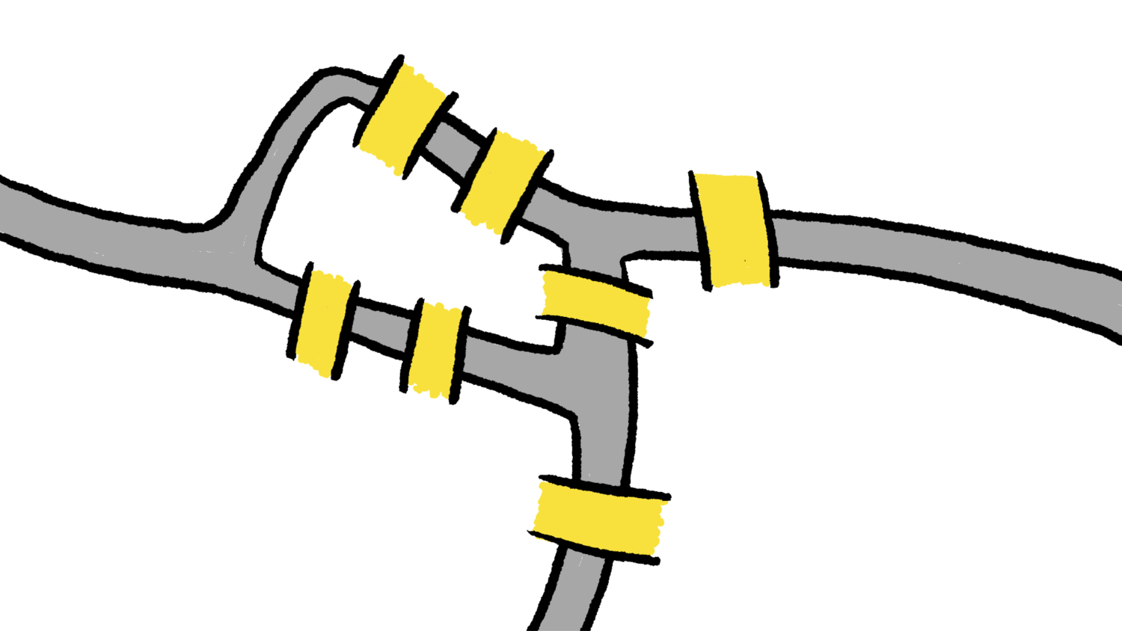
This arrangement of Königsberg's seven bridges led people to ask a simple yes-or-no question. Could you start anywhere in the city and cross every bridge exactly once? (No swimming allowed!)

Slide 6
It's easy to attempt the puzzle and get stuck. Here is a path through the city that gets stuck after crossing four bridges.

Slide 7
It turns out that it was not possible to cross all seven bridges of Königsberg exactly once, even if you can start and end anywhere.
The interesting computer science enters the picture when you try to explain why you can't achieve this goal!

Slide 8
Can you find a path that crosses six bridges before getting stuck? Remember, you're not allowed to cross any bridge twice.

Slide 9
Let's turn the problem on its head to make sure we understand it. If you're allowed to start anywhere, but you can't cross any single bridge twice, what is the fewest number of bridges you can cross before getting stuck?

Slide 10
If you didn't know whether or not there was a solution to the puzzle of the bridges of Königsberg, you could try to find one by moving around randomly. Start at a random place, and then move across a random bridge until you succeed or get stuck.

Slide 11
Repeating this process over and over will always eventually find a path if there is a path to be found. However, repeatedly performing random explorations is not a good way for us to convince ourselves that no path exists. We can never be sure that there's not some solution we've missed by getting unlucky!
You might try to imagine a systematic way to explore the city, a method that ensures you will try every possible combination of bridges. One systematic way of exploring that computer scientists use is called depth-first search, but that's a topic for a different lecture/ discussion.

Slide 12
In computer science, it's sometimes useful to look for a brute force solution.
If you can describe what all the possible solutions look like, and if you can check what it means for a solution to be correct or valid, then just check all the possible solutions until you find one that works!

Slide 13
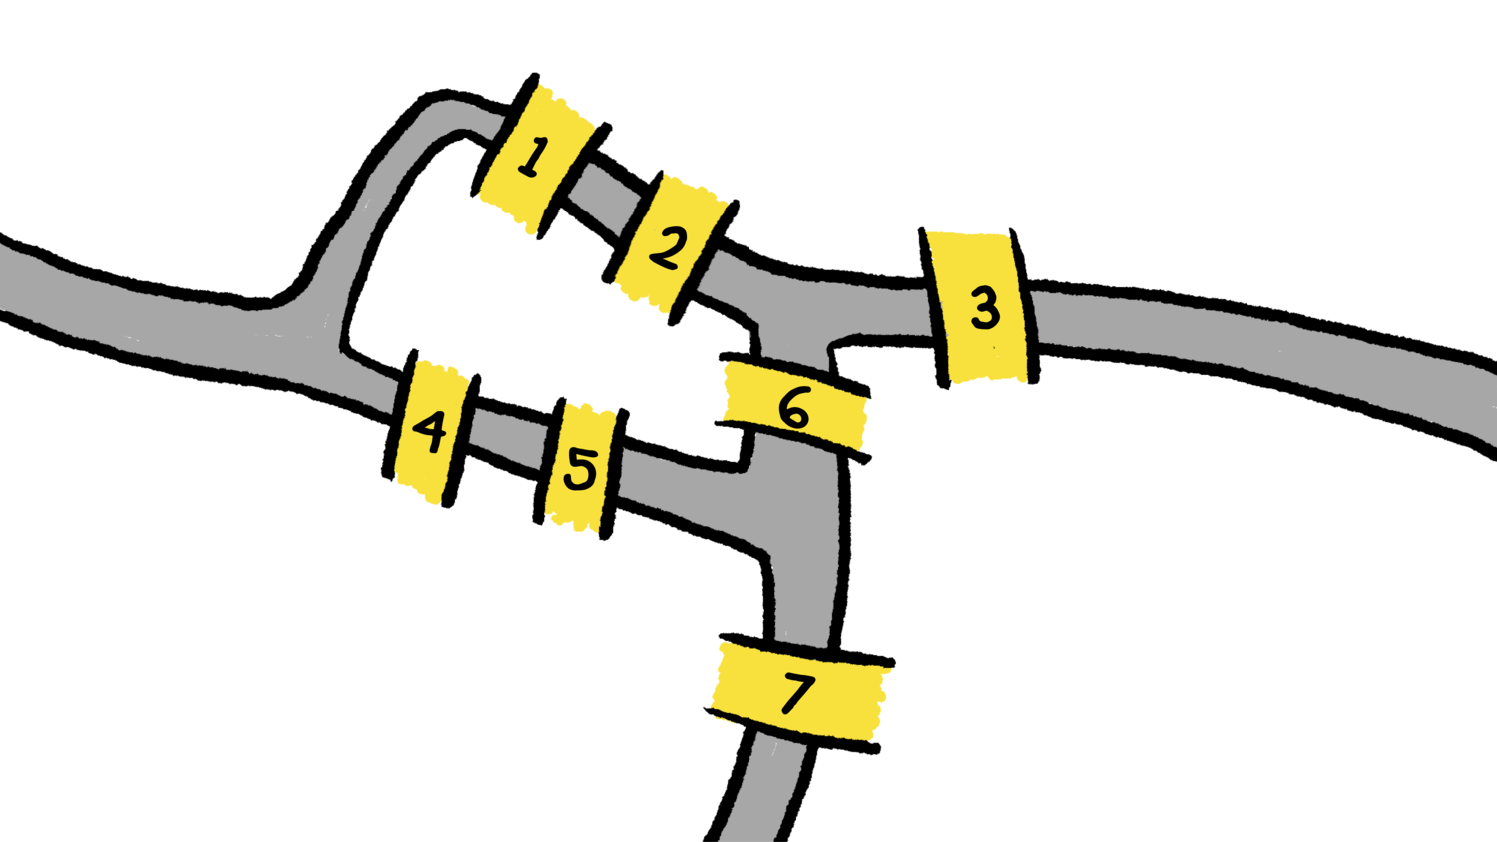
In the case of the bridges of Königsberg, we can number the seven bridges 1, 2, 3, 4, 5, 6, and 7.

Slide 14
Any solution to the puzzle is going to be some sequence of seven bridges that includes each of the seven bridges: that is, a permutation of the sequence 1, 2, 3, 4, 5, 6, 7.
We can list each possible permutation, and then check each permutation in turn to see if that sequence of bridges represents a path that we can physically walk (without crossing a river). If even one of these sequences is possible to carry out, then it represents a solution to the puzzle.

Slide 15
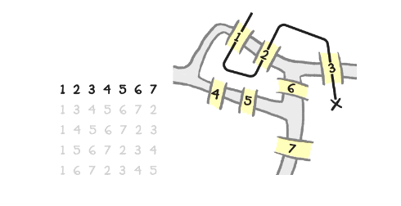
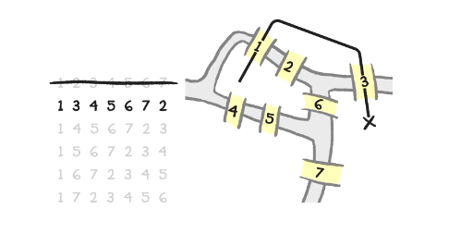
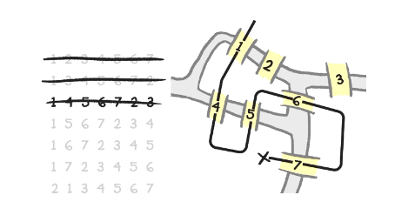
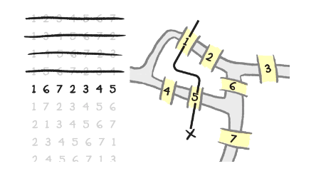
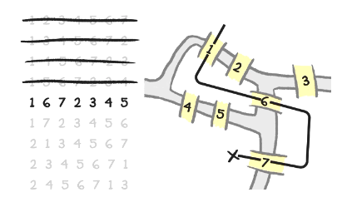
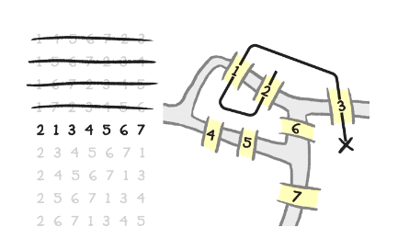

Slide 16
How many bridge permutations would we need to check in order to be sure that there is no way to walk the seven bridges of Königsberg exactly once?
Correct answer: About 5,000
The number of permutations of 7 elements is 7! =1×2×3×4×5×6×7=5040.
This is probably too many to check by hand, but with a computer we can check each of these examples pretty quickly!

Slide 17
Imagine that a computer can check 5040 different permutations of bridges every second. (That would mean that it only takes a second to check all the permutations of bridges in Königsberg.)
A 2006 study of Pittsburgh, Pennsylvania determined that the city had 446 bridges.

Slide 18
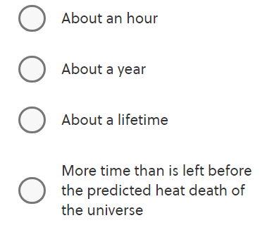
If we use the same approach to see whether all the bridges in Pittsburgh can be crossed once without leaving any roadways, how long would that take?

Slide 19
Correct answer: More time than is left before the predicted heat death of the universe
The factorial function n! measures the number of permutations of n elements, and the factorial function gets way bigger as n gets bigger.
The easy way to guess the answer is to use the rule of thumb that the factorial function gets really big, really fast.

Slide 20
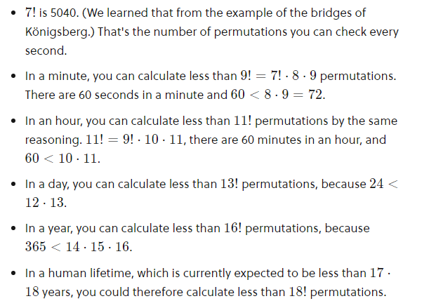

Slide 21
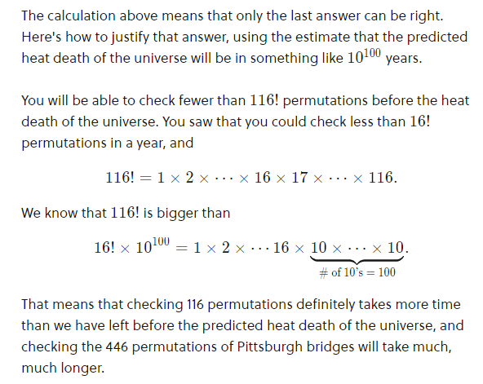

Slide 22
Conclusion
It isn't too hard to figure out if any specific sequence of bridges represents a valid way through Königsberg. We can therefore solve the puzzle of the bridges of Königsberg by listing all the permutations of bridges and checking whether each combination works.
This brute force solution is not a particularly satisfying solution! It certainly doesn't help us once there are a couple more bridges.

Slide 23
Conclusion
For many important puzzles in computer science, the best way we know how to find an ideal solution is by brute force: listing all the possible solutions and then quickly checking each possible solution. (Maybe that's because there isn't any better way, but maybe that's because there is a better way and we just haven't thought of it yet! For most of the important problems involving brute force search, we don't know!)
Solving problems with brute force is an important tool in the computer science toolbox. However, brute force problem solving gets a lot harder when the solutions get only a little bit more complex.

Slide 24
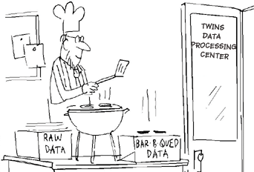
C H A P T E R 2
Data Manipulation
Central Processing Unit
(CPU)

Slide 25
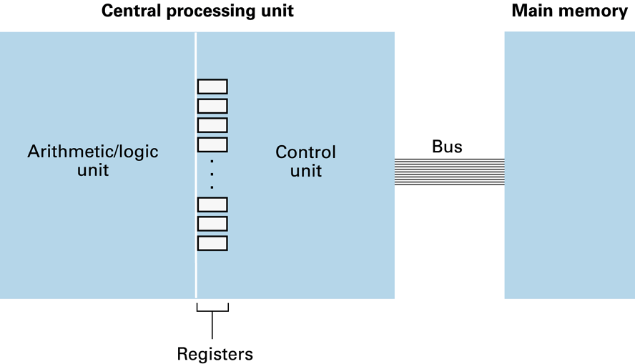
2.1: The ‘Von Neumann Architecture’: CPU and Main Memory connected via a Bus
isolated from main memory
data manipulation
coordination of activities
temporary storage

Slide 26
2.1: Central role of the Control Unit
To perform an operation on data stored in main memory, the control unit must
transfer the data from main memory into registers
inform the arithmetic/logic unit which registers hold the data
activate appropriate arithmetic/logic unit circuitry
tell the arithmetic/logic unit which register should receive the result
transfer the result from that register to main memory.

Slide 27
2.1: Flexibility of Execution
Early computers were not flexible
operations were built into control unit
Programs now encoded/stored in main memory
known as: stored-program concept
As a consequence, the control unit must also
fetch (extract) the program from main memory
decode the set of instructions
execute each instruction in turn

Slide 28
Any Questions?
Notes:
Reading
Richard Fayman -> Biography -> Interesting to read-> Physics lectures
Algorithms are eating our work-> Ted Talk.
Computer Limitations -> Travel’s sale man problem.
Contents are books, Grading -> not required
Less Text should be replaced by Images.
Slides makes students passive.

